Slide 1

WAY TO ENTERPRISE
Advanced Java
VTI ACADEMY
Author: duy.nguyenngoc1@vti.com.vn
March 2020

Slide 2
Agenda
Hello World Spring Data JPA
Spring Data Introduction
Custom Query
Paging & Sorting
Lombok
Spring Boot Devtools
Assignments
Copyright © VTI Academy All Rights Reserved

Slide 3
Hello World Spring Data JPA
Step 1: Create Spring Project
Step 2: Config database into application.properties file
Step 3: Create Persistent Object
Step 4: Create interface JpaRepository
Step 5: Create service & controller
Step 6: Start Server
Step 7: Test

Slide 4
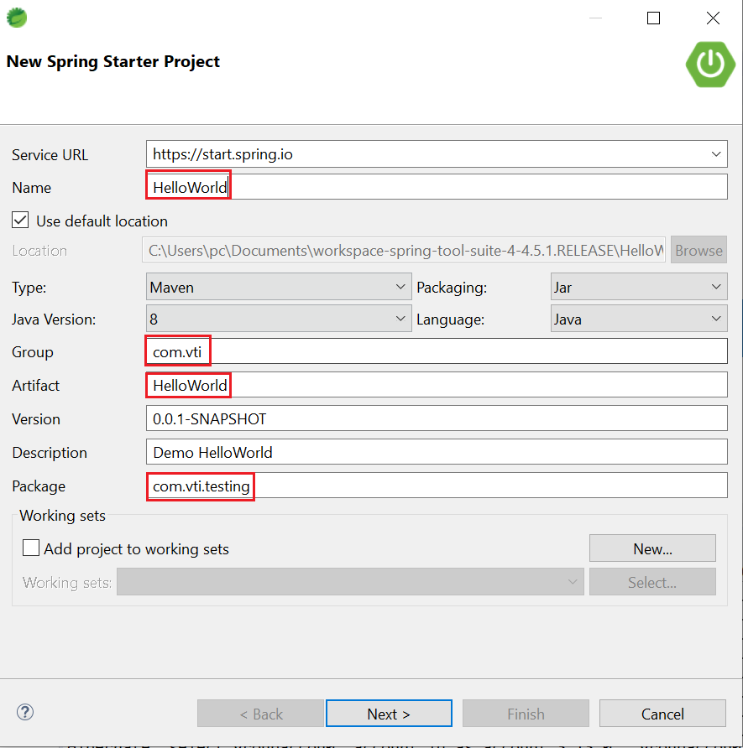
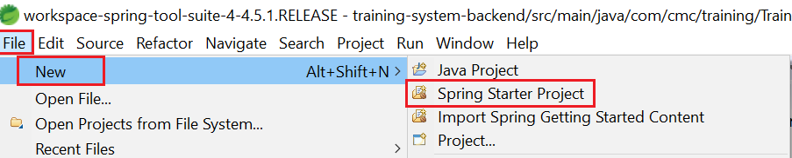
Hello World Spring Data JPA
Step 1: Create Spring Project

Slide 5
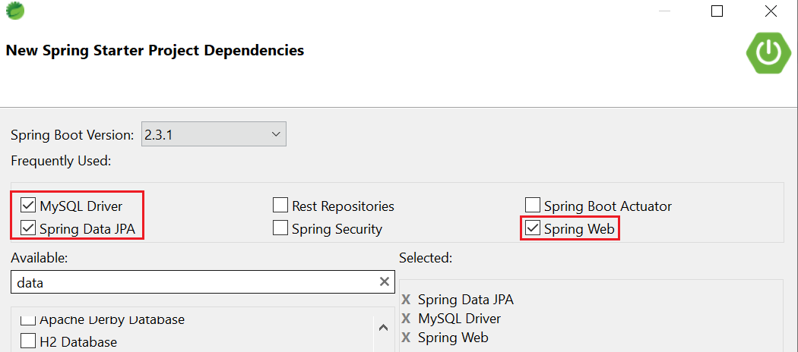
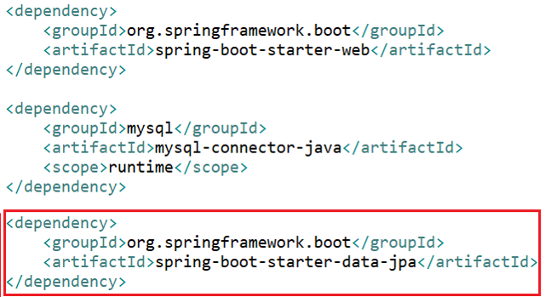
Hello World Spring Data JPA

Slide 6
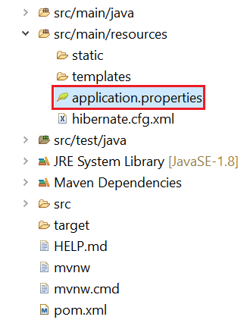
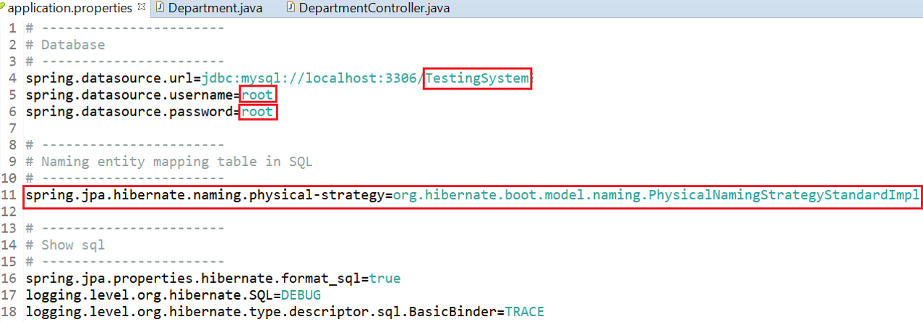
Hello World Spring Data JPA
Step 2: Config database into application.properties file

Slide 7
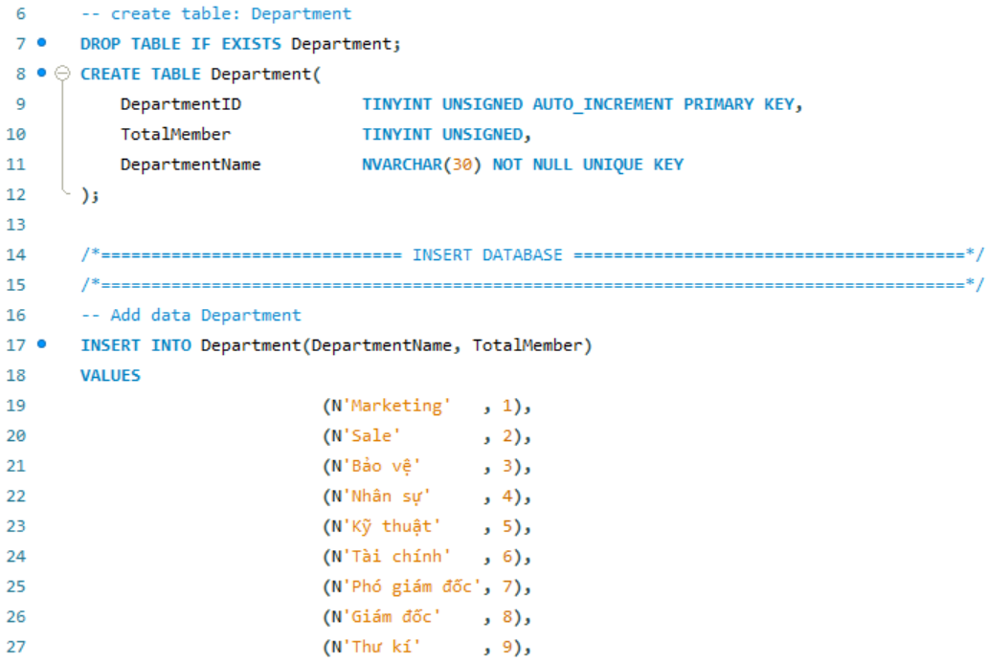
Hello World Spring Data JPA

Slide 8
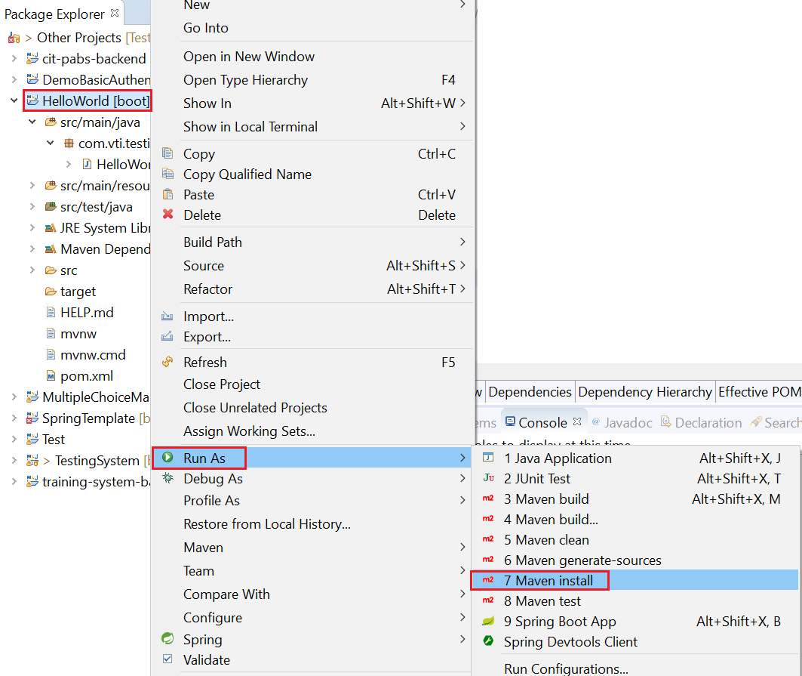
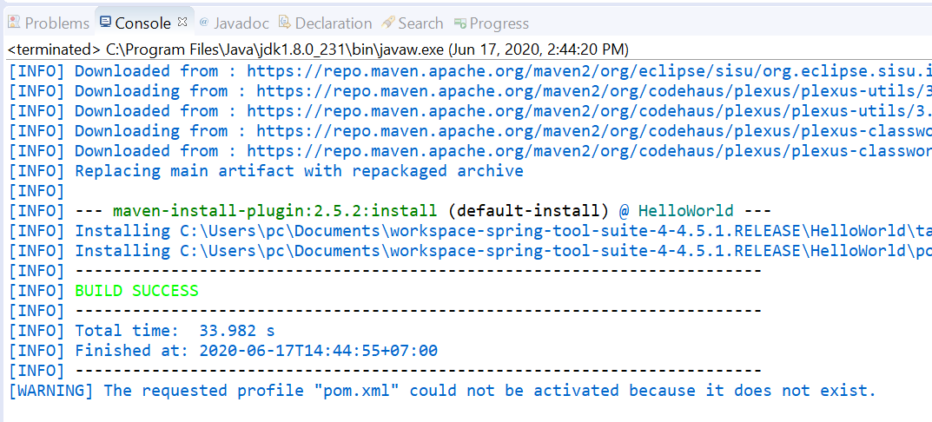
Hello World Spring Data JPA

Slide 9
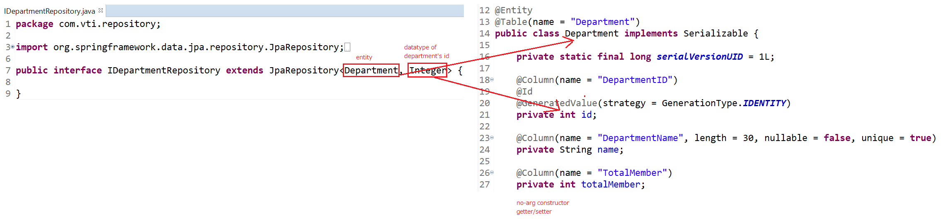
Hello World Spring Data JPA
Step 3: Create Persistent Object
Step 4: Create interface JpaRepository

Slide 10
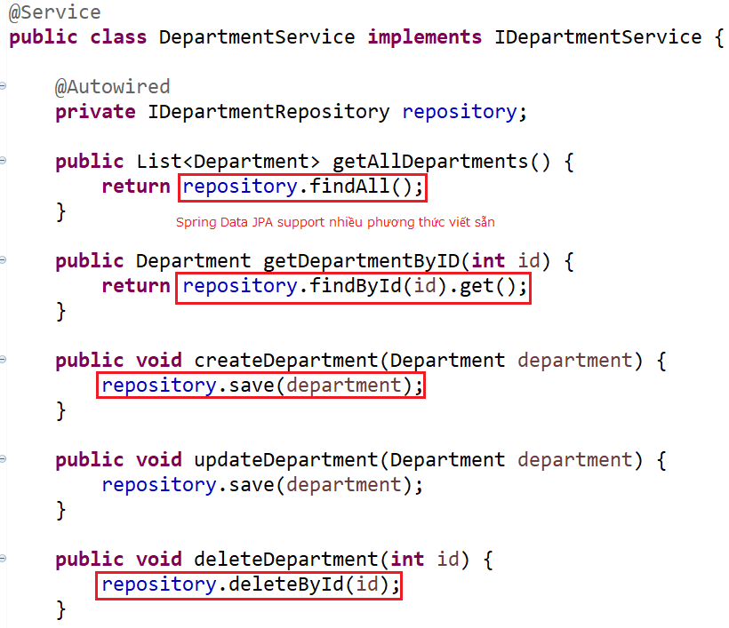
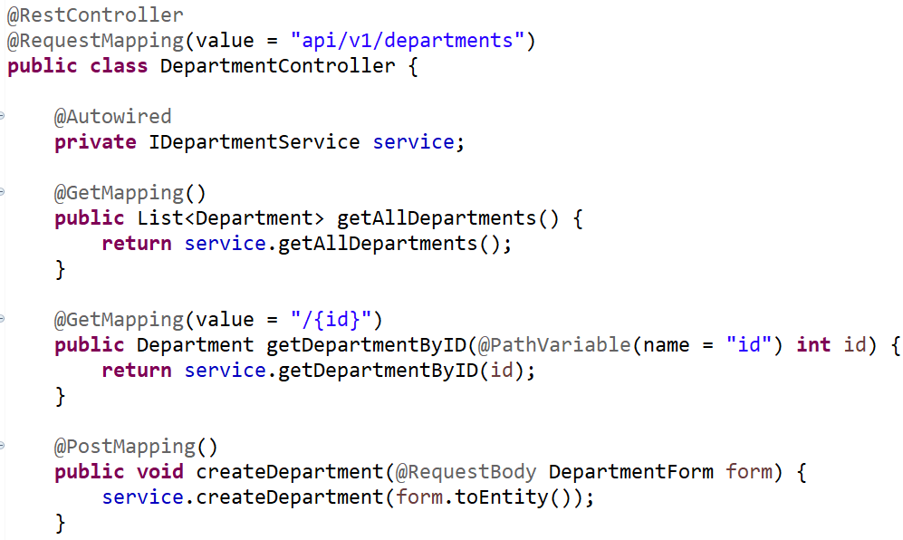
Hello World Spring Data JPA
Step 5: Create service & controller

Slide 11
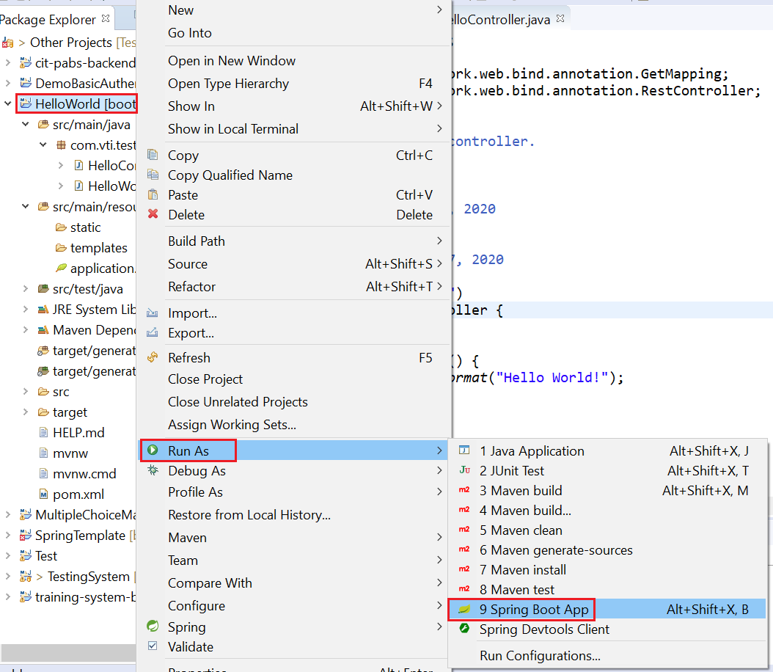
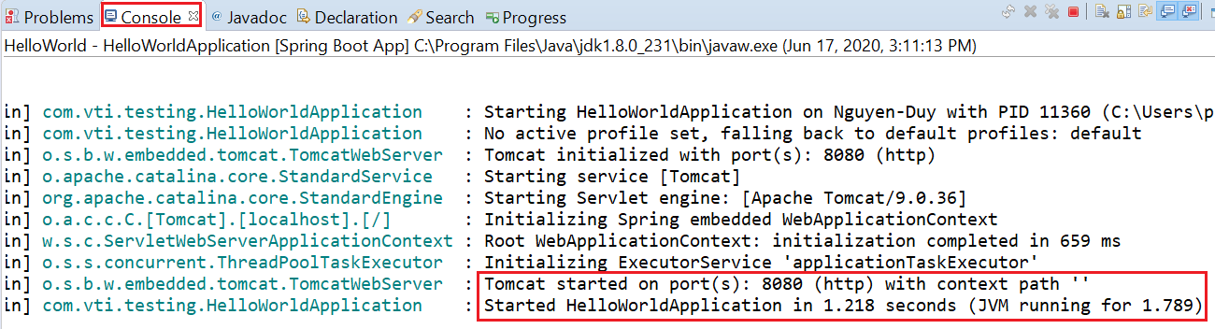
Hello World Spring Data JPA
Step 6: Start Server

Slide 12
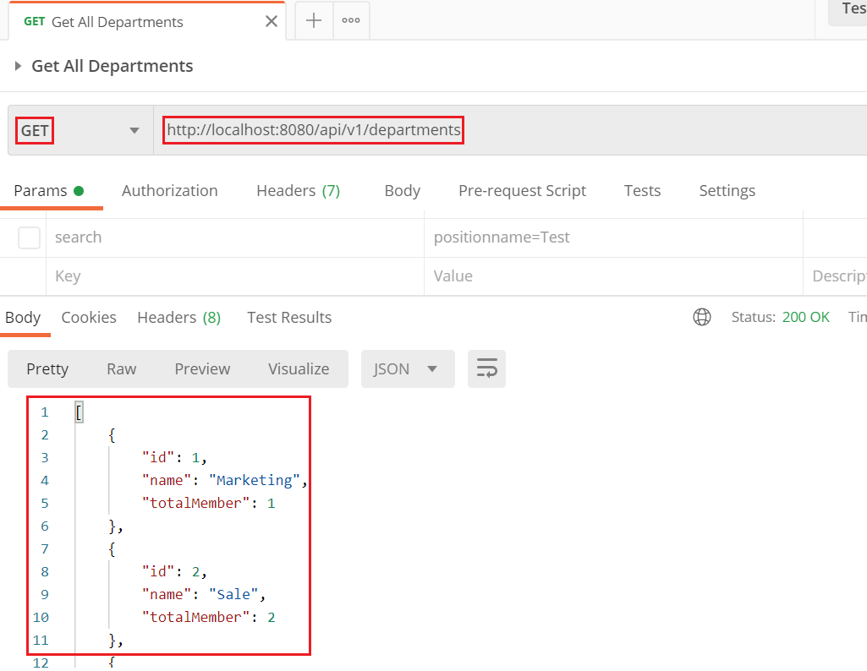
Hello World Spring Data JPA
Step 7: Test

Slide 13
Testing System Assignments
Self-practice

Slide 14
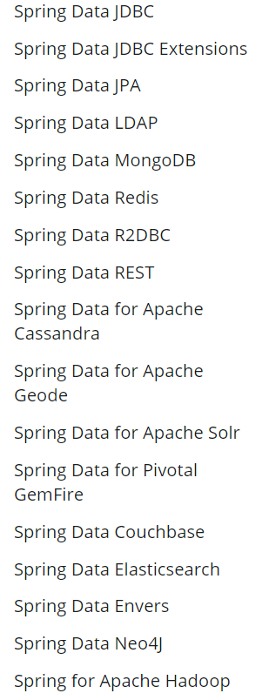
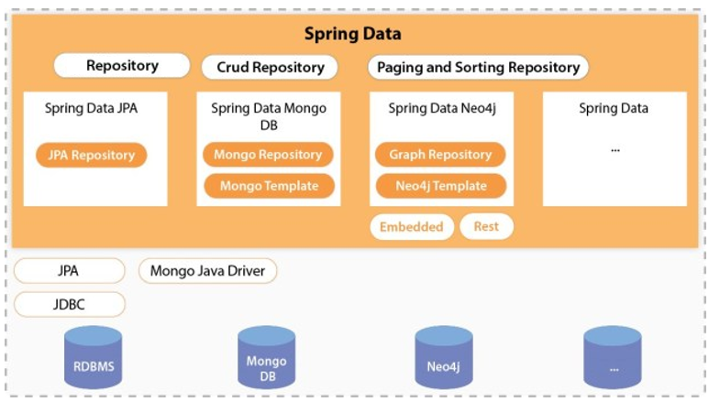
Spring Data
Working with both SQL & NoSQL
Spring Data JPA Generated DAO ➔ No More DAO Implementations
Main tasks
CRUD (Create, Read, Update, Delete)
Pagination, Sorting and Filtering
https://spring.io/projects/spring-data

Slide 15
Spring Data
Support multiple features:
Custom Query
Paging & Sorting
Specification (Where)
Transaction (Next Lesson)
Spring Data Rest (Next Lesson)

Slide 16
Spring Data
Custom Query
Method names
@Query Annotation
Named Queries (Self-study)

Slide 17
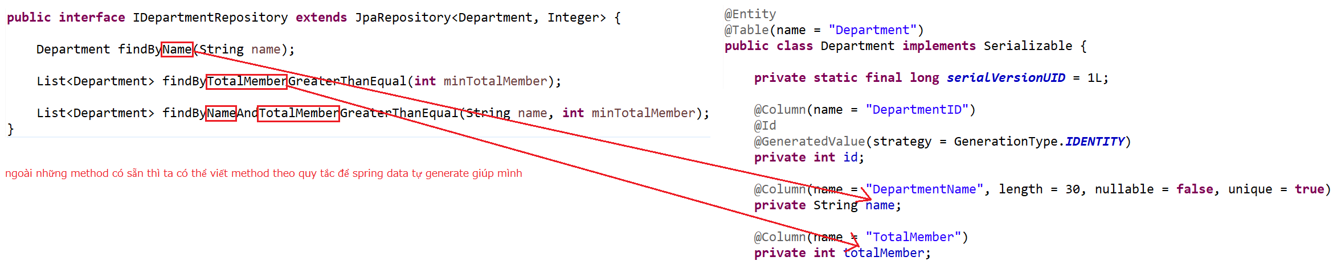
Spring Data
Method names
Repository

Slide 18
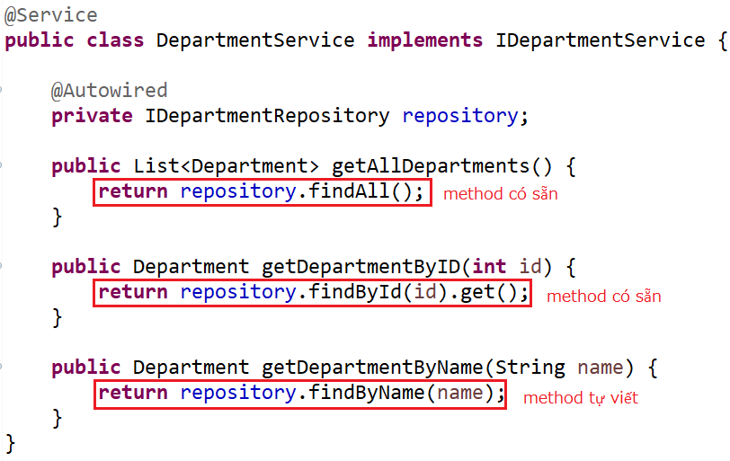
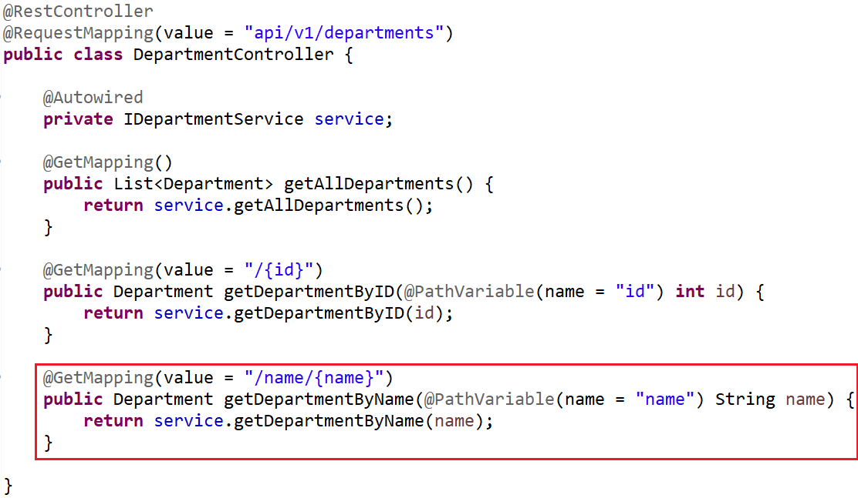
Spring Data
Service & Controller

Slide 19
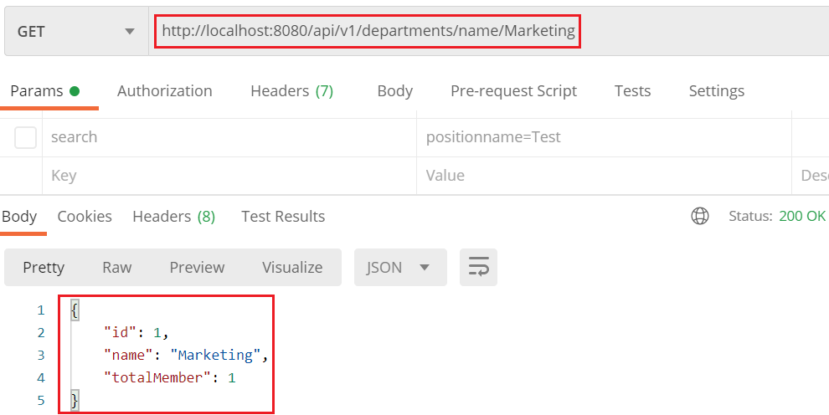
Spring Data
Test

Slide 20
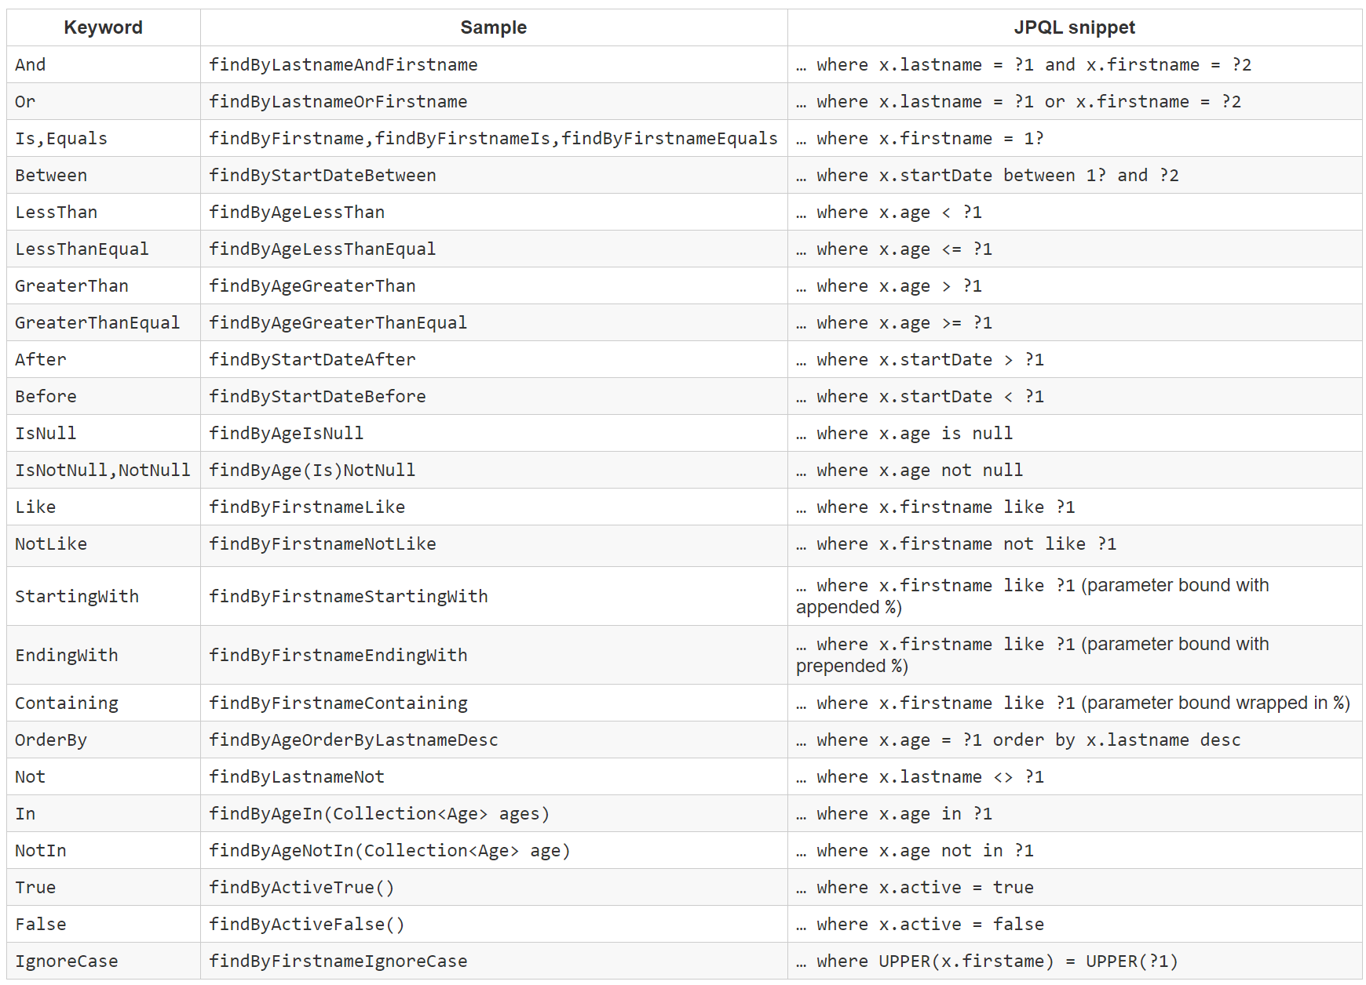
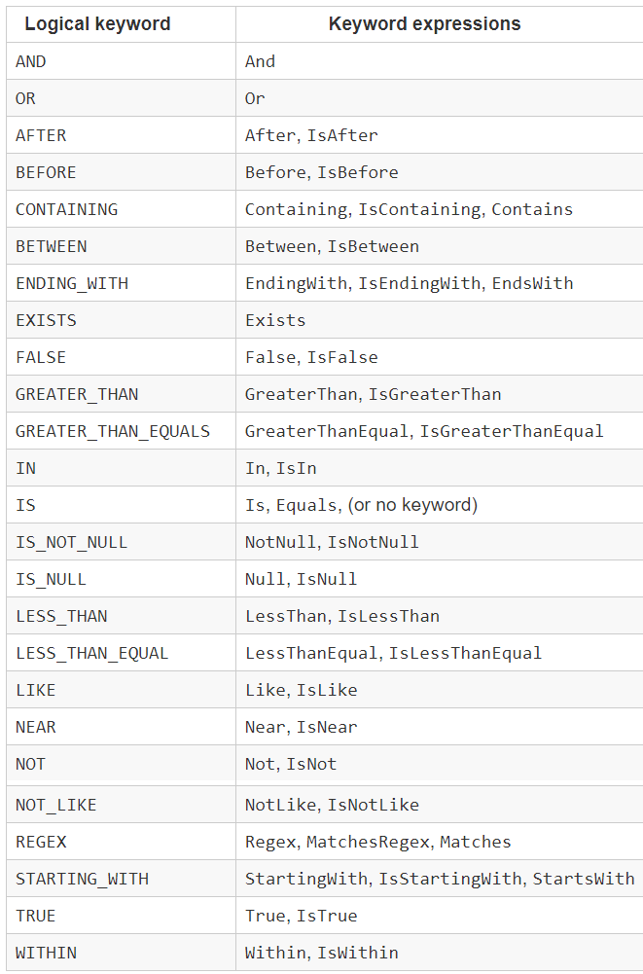
Spring Data
Name Pattern
Operator Pattern

Slide 21
Testing System Assignments
Self-practice

Slide 22
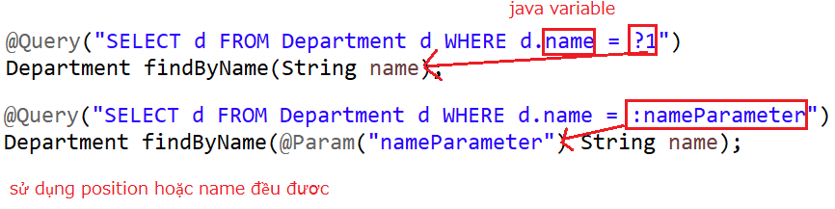
Spring Data
@Query Annotation
HQL
SQL

Slide 23
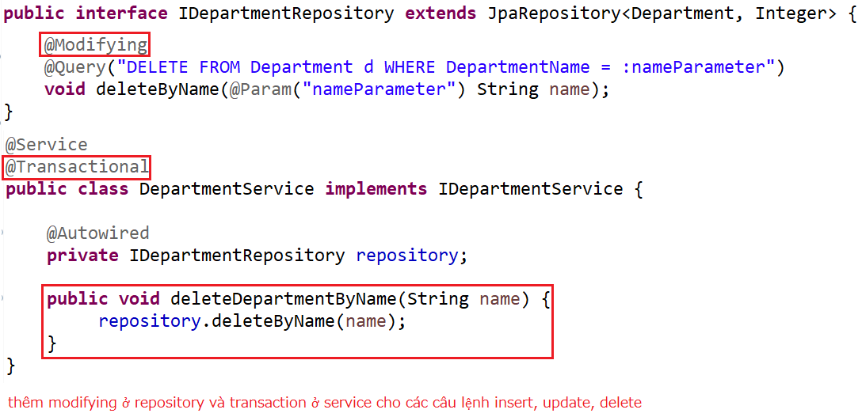
Spring Data
Modifying @Query with Transaction
Repository & Service

Slide 24
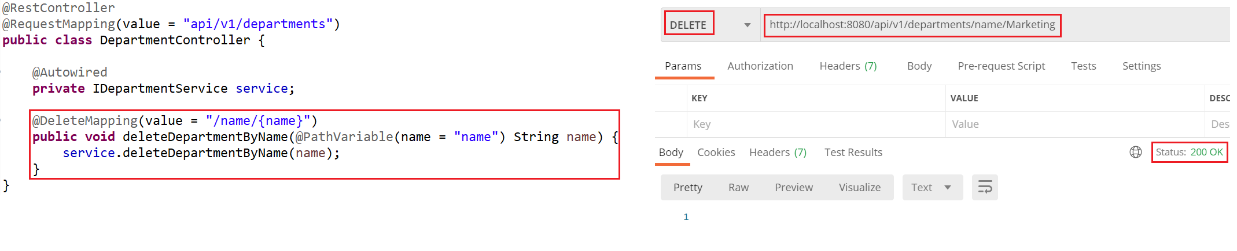
Spring Data
Controller & Test

Slide 25
Spring Data
Named Queries (Self-study)
https://attacomsian.com/blog/spring-data-jpa-named-queries

Slide 26
Testing System Assignments
Self-practice

Slide 27
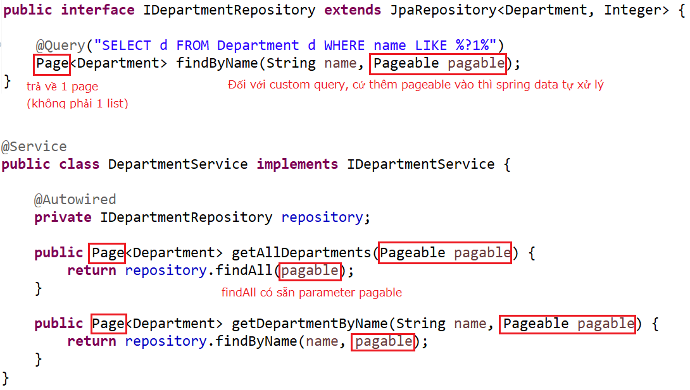
Spring Data
Paging & Sorting
Repository & Service

Slide 28
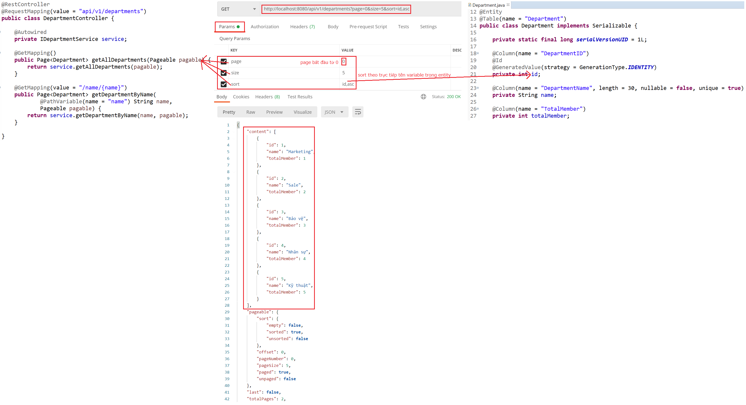
Spring Data
Controller & Test

Slide 29
Testing System Assignments
Self-practice

Slide 30
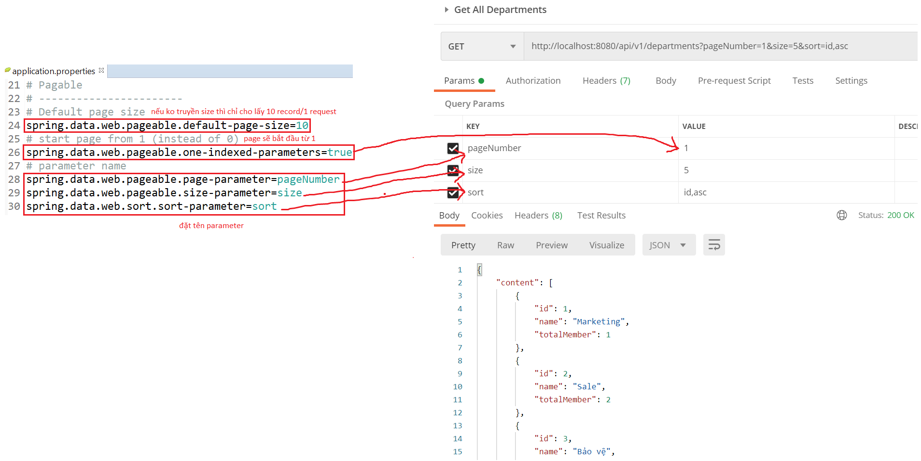
Spring Data
Config parameter

Slide 31
Other
Lombok
Spring Boot Devtools

Slide 32
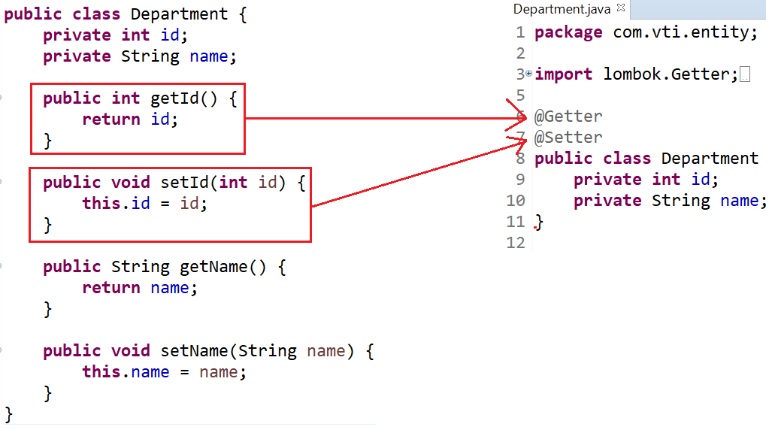
Lombok
Lombok
Auto generate getter/setter, constructor, toString(), equal(), ....
Home page: https://projectlombok.org/

Slide 33
HelloWorld with Lombok
Step 1: Download and install Lombok plugin
Step 2: Create maven project & Add Lombok library
Step 3: Using
Step 4: Test

Slide 34
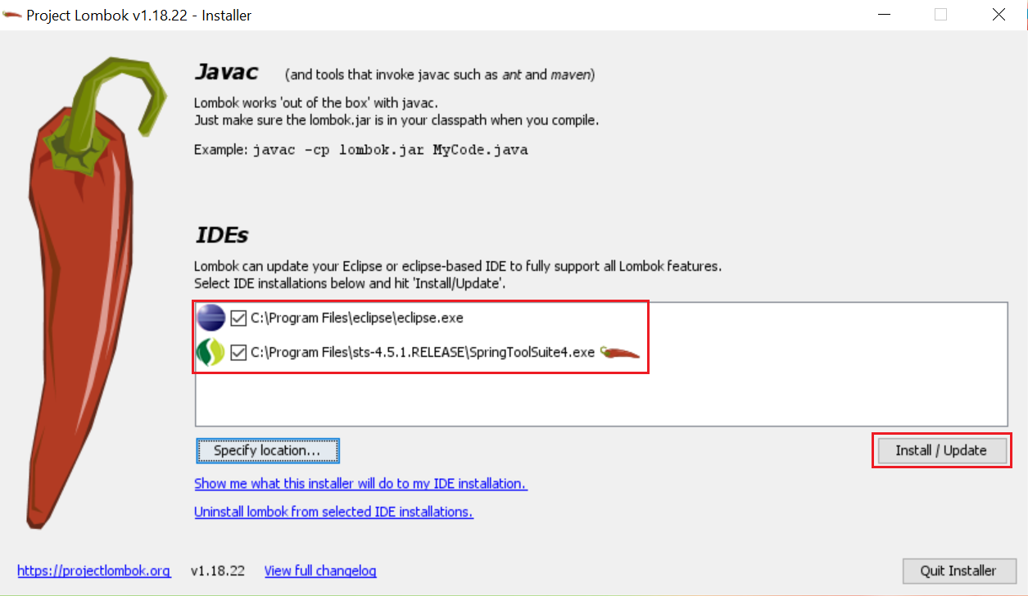
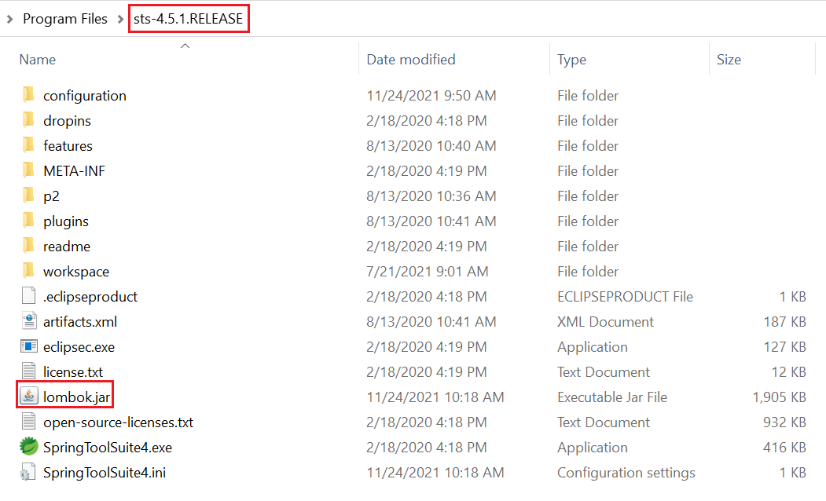
HelloWorld with Lombok
Step 1: Download and install Lombok plugin
https://projectlombok.org/download
Restart IDE

Slide 35
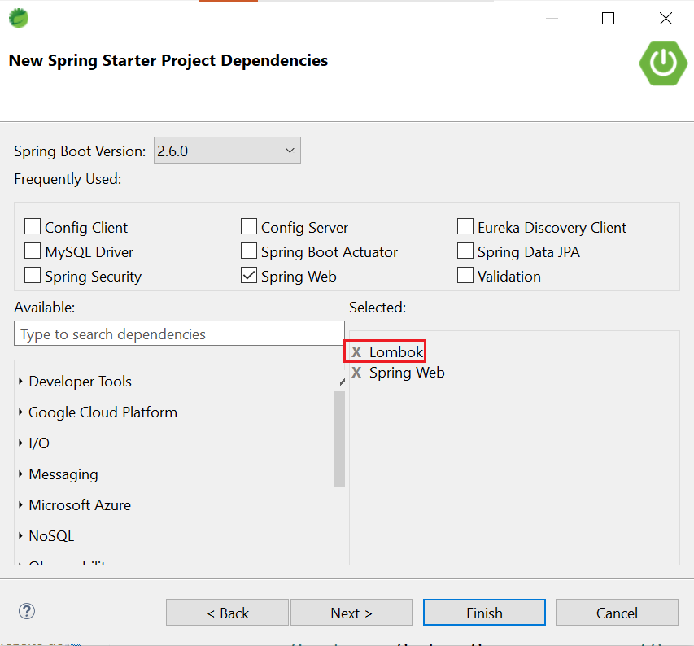
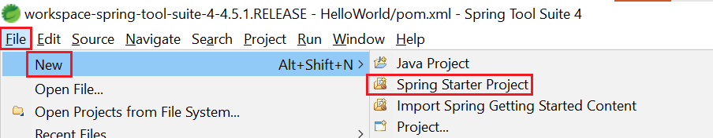
HelloWorld with Lombok
Step 2: Create maven project & Add Lombok library

Slide 36
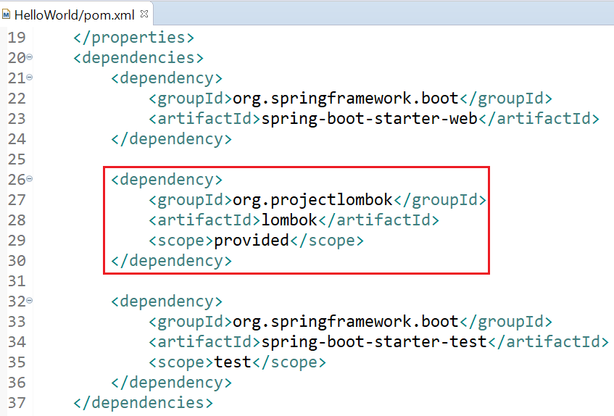
HelloWorld with Lombok
Restart IDE

Slide 37
HelloWorld with Lombok
Step 3: Using
@Getter @Setter

Slide 38
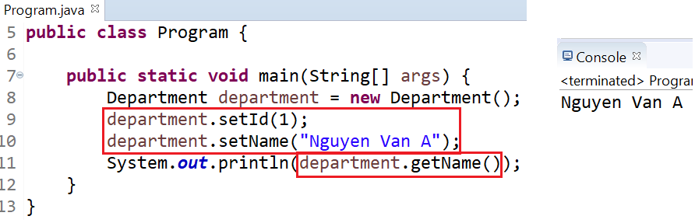
HelloWorld with Lombok
Step 4: Test

Slide 39
Testing System Assignments
Self-practice

Slide 40
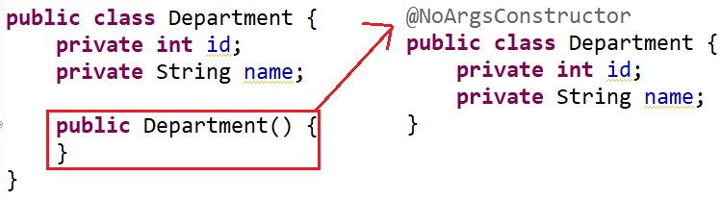
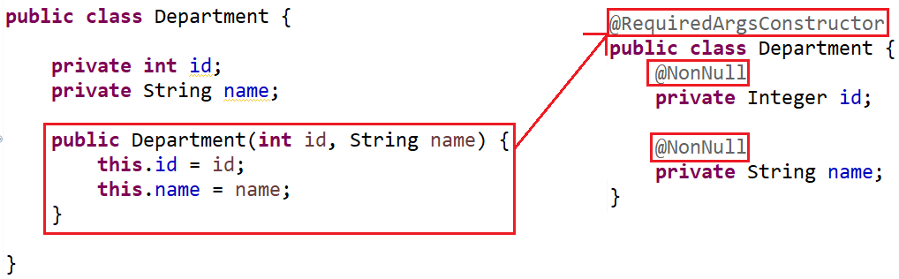
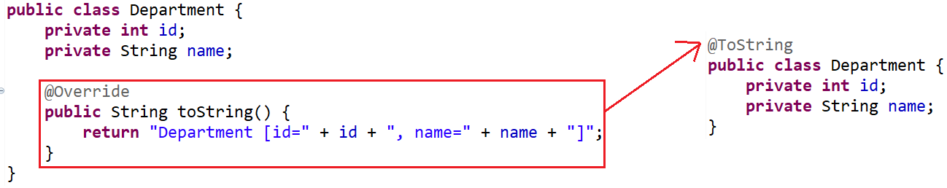
Lombok
@NoArgsConstructor
@Getter @Setter
@RequiredArgsConstructor
Similar to @EqualsAndHashCode
@ToString

Slide 41
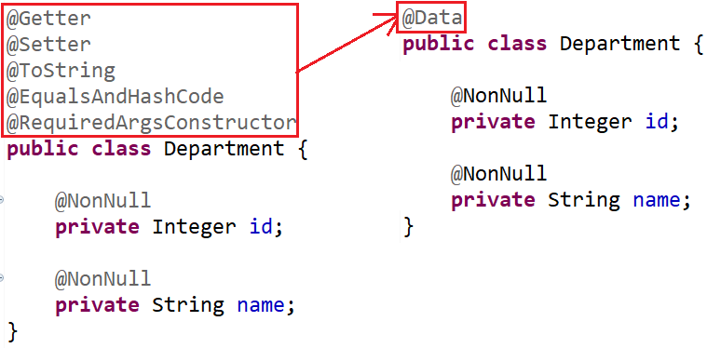
Lombok
@Data

Slide 42
Testing System Assignments
Self-practice

Slide 43
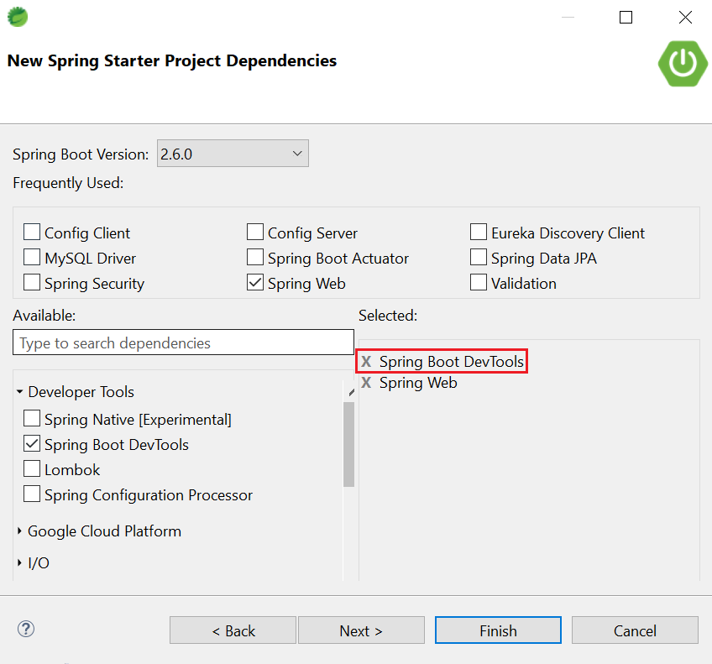
Spring Boot Devtools
Auto reload when changing code

Slide 44
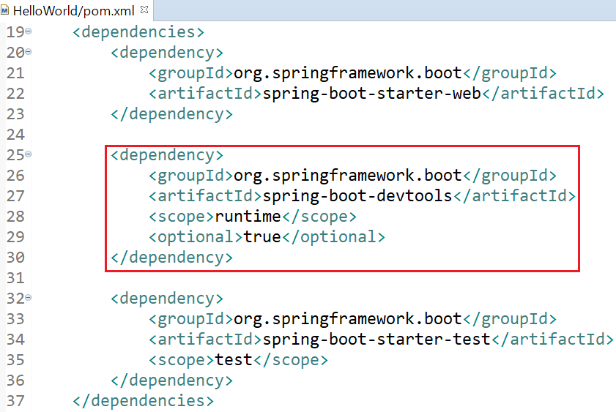
Spring Boot Devtools

Slide 45
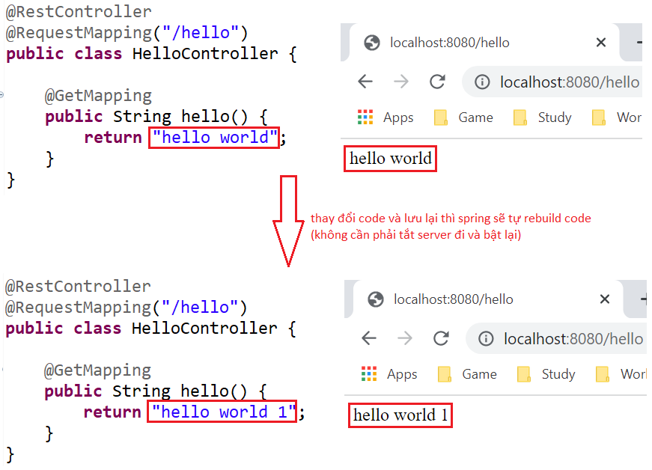
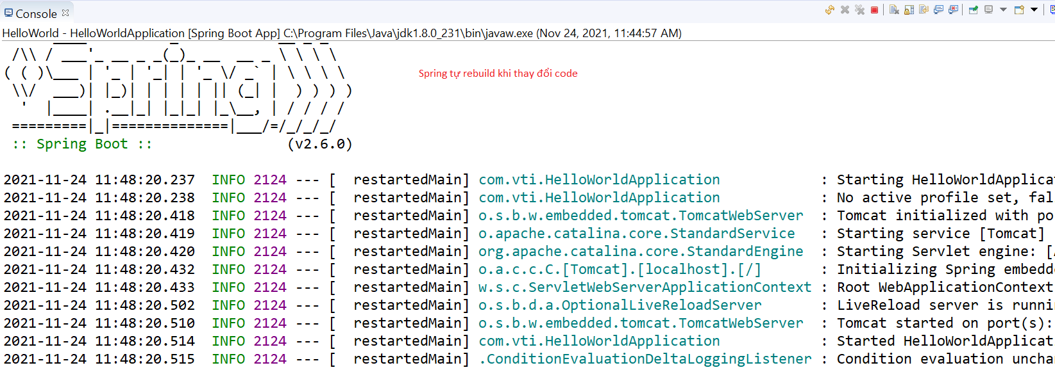
Spring Boot Devtools

Slide 46
Testing System Assignments
Self-practice

Slide 47
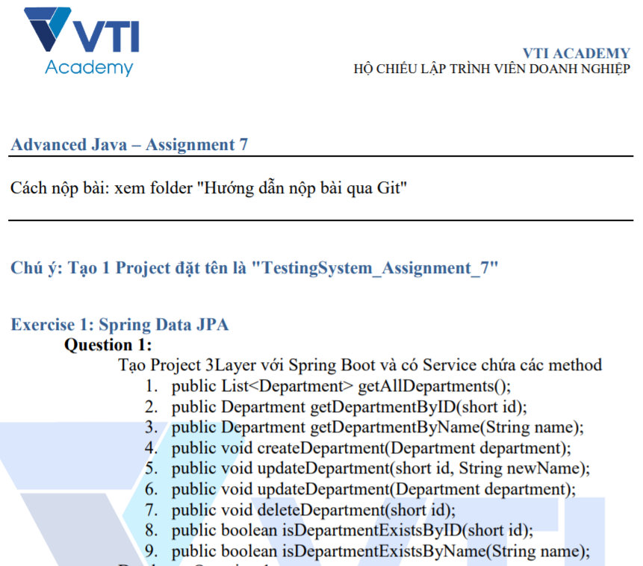
Testing System Assignments

Slide 48
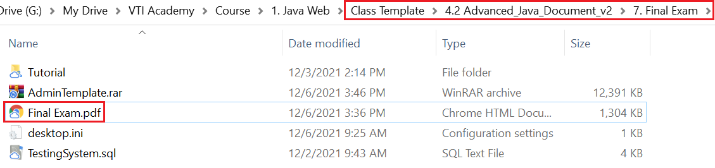
Final Exam
Học viên bắt đầu làm Final Exam từ giờ

Slide 49
Reference
https://www.baeldung.com
https://spring.io/projects/spring-boot
https://spring.io/guides#getting-started-guides

Slide 50
Q & A
Copyright © VTI Academy All Rights Reserved

